Slide 1

HSBC's Comprehensive Digital Banking Revamp
Suneel Srikanta
Shahadat Molla
Sai Varshith Reddy
Sai Tarun Reddy
Koushik a
Avinash VallabhanenIi
Team White

Slide 2

Agenda
Project Overview
Project Objective
Benefits of Using a WBS
Major Components
WBS Component Breakdown
Illustration of WBS
Q & A

Slide 3

Project Overview
The purpose of the HSBC global digital banking platform overhaul is to transform and modernize HSBC’s digital banking infrastructure to enhance customer satisfaction, fortify security, and optimize operational efficiency. This initiative is crucial for maintaining HSBC’s position as a leader in digital banking and adapting to evolving market demands and regulatory requirements.
Project Sponsor: Global Head of Digital Banking.

Slide 4

Project Objective
1
Enhance Customer Experience
Improve UX for accessible digital banking platform to exceed
customer expectations globally.
2
Boost Security
Implement advanced security to safeguard data, transactions, and privacy, ensuring global regulatory compliance.
3
Streamline Operations
operations to boost efficiency, reduce redundancies, and ensure smooth customer account migration without disruptions
4
Ensure Compliance
Ensure compliance with international regulations and standards throughout the project and beyond.

Slide 5
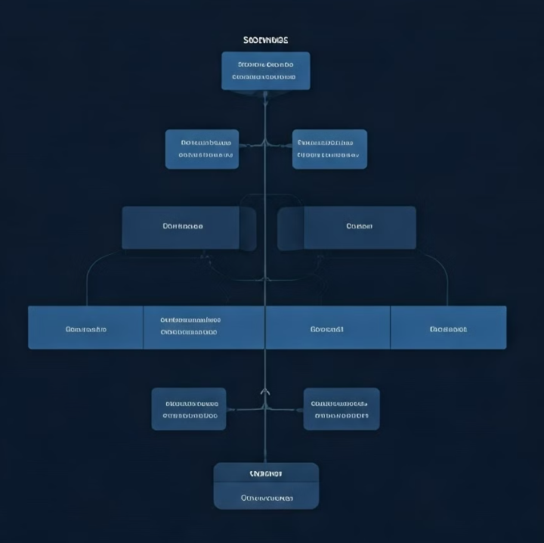
Benefits of WBS
Facilitates responsibility assignment.
Improves team communication.
Supports risk management.
Provides structured vision of project.

Slide 6
Identify Major Components
Platform Redesign
Security Enhancement
Operational Streamlining
Comprehensive overhaul of user interfaces and underlying architecture. Focuses on intuitive design and robust functionality.
Implementation of advanced cybersecurity measures. Includes new protocols and multi-factor authentication systems. Compliance with PSD2 standards for third-party integration
Optimization of backend processes and systems. Aims to improve efficiency and reduce operational bottlenecks.

Slide 7






Work Breakdown Structure Overview
Project Planning and Analysis
Design & Development
Testing and Quality Assurance
User-based Discounts & Billing
Deployment & Launch
Post Launch Support & Maintenance

Slide 8




Stakeholder Identification
Internal
Employees, managers, and executives directly involved.
External
Clients, vendors, and regulatory bodies.
Indirect
Community members and industry influencers.

Slide 9
Risk Analysis
Identify Risks
Assess Impact
Develop Strategies
Brainstorm potential threats and opportunities.
Evaluate likelihood and consequences of risks.
Create plans to mitigate or leverage risks.

Slide 10
Design & Development
UI/UX Design
Frontend Development
Backend Integration
Create wireframes and user interface mockups.
Build responsive and interactive app components.
Develop server-side logic and database structures.

Slide 11
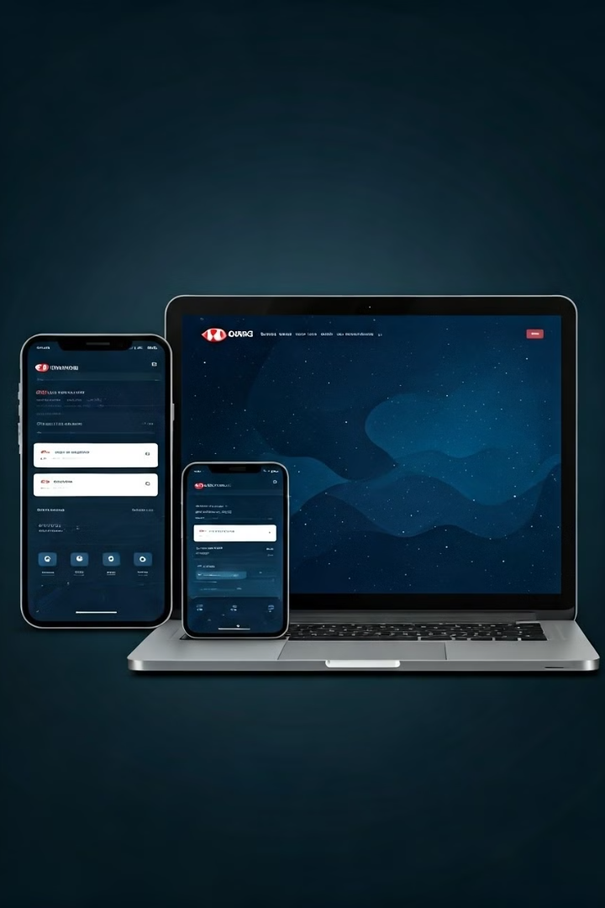
Platform Redesign
User-Centric Design
Responsive Framework
Implement intuitive navigation and personalized user experiences across all digital touchpoints.
Ensure seamless functionality across devices, from smartphones to desktops.
Performance Optimization
Accessibility Features
Incorporate inclusive design principles to cater to users with diverse needs.
Enhance loading speeds and real-time transaction processing for improved user satisfaction.

Slide 12
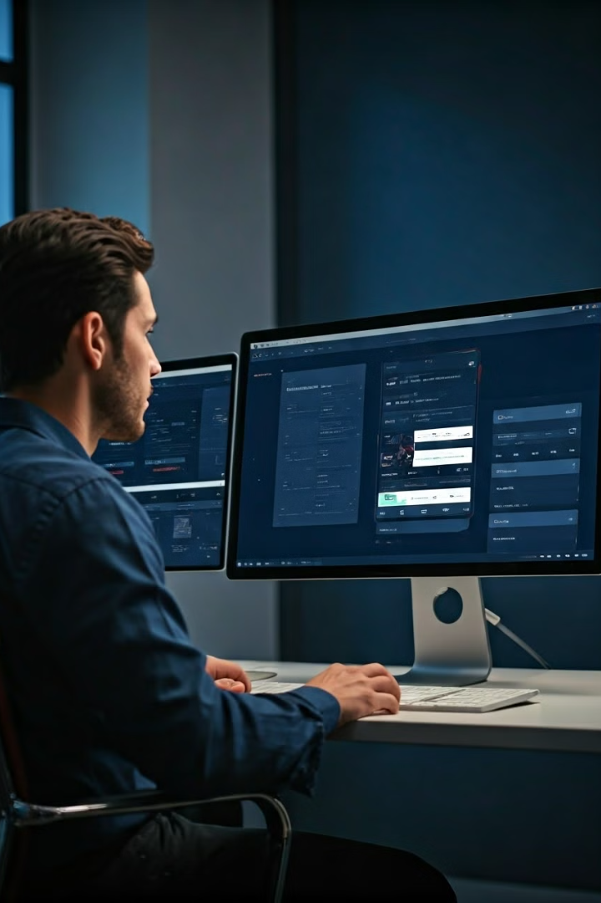




UI/UX Redesign
Color Scheme
Layout
Refresh brand colors for a modern, trustworthy feel.
Optimize information hierarchy for intuitive navigation.
Animations
Accessibility
Add subtle transitions for a smoother user experience.
Ensure compliance with WCAG guidelines for inclusive design.

Slide 13
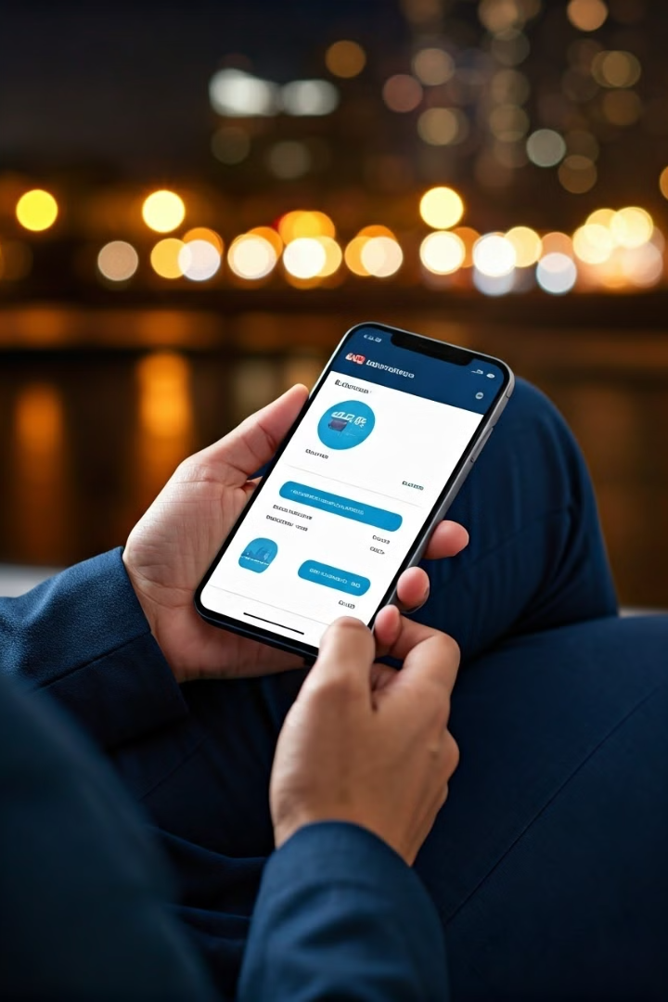
Mobile App Update
Feature
Benefit
Biometric Login
Enhanced security and quick access
Personalized Insights
AI-driven financial advice
Instant Transfers
Seamless global money movement
Virtual Assistant
24/7 customer support

Slide 14
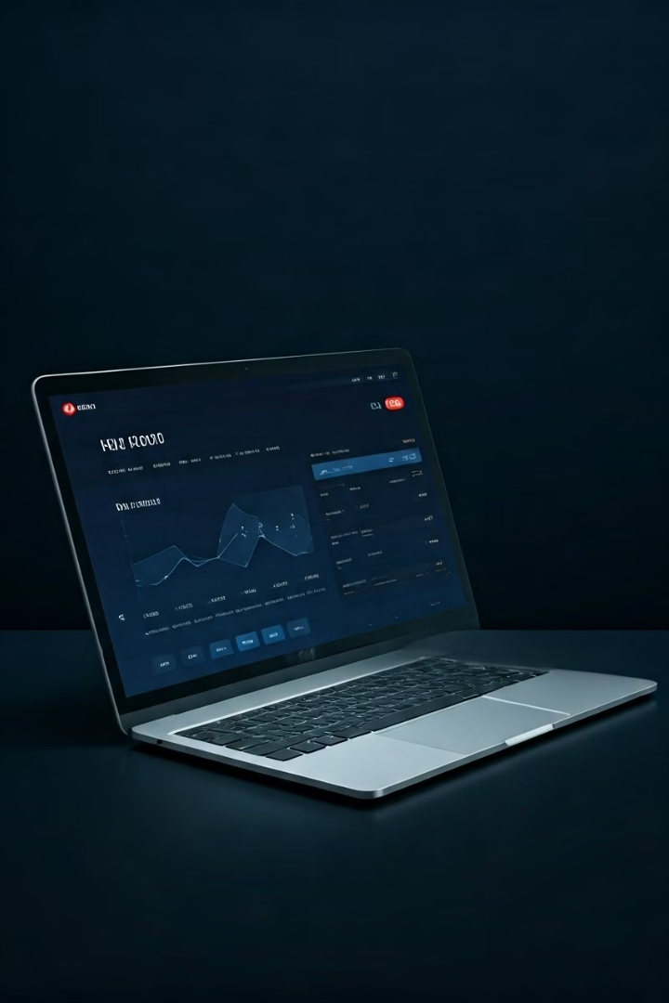
Web Interface Revamp
1
Streamlined Dashboard
2
Advanced Search
Intelligent search functionality to easily locate transactions, statements, and banking services.
Centralized view of accounts, investments, and recent transactions for quick financial overview.
3
Customizable Widgets
4
Cross-Device Sync
Drag-and-drop modules allowing users to personalize their banking homepage.
Seamless transition between web and mobile interfaces, maintaining consistent user experience.

Slide 15



Security Enhancement
Biometric Authentication
End-to-End Encryption
AI-Powered Fraud Detection
Implement advanced fingerprint and facial recognition for secure account access.
Enhance data protection with military-grade encryption for all transactions.
Deploy machine learning algorithms to identify and prevent suspicious activities in real-time.

Slide 16

Testing and Quality Assurance
1
Unit Testing
Verify individual components function correctly.
2
Integration Testing
Ensure different modules work together seamlessly.
3
User Acceptance Testing
Gather feedback from beta testers.
4
Performance Optimization
Improve app speed and resource usage.

Slide 17
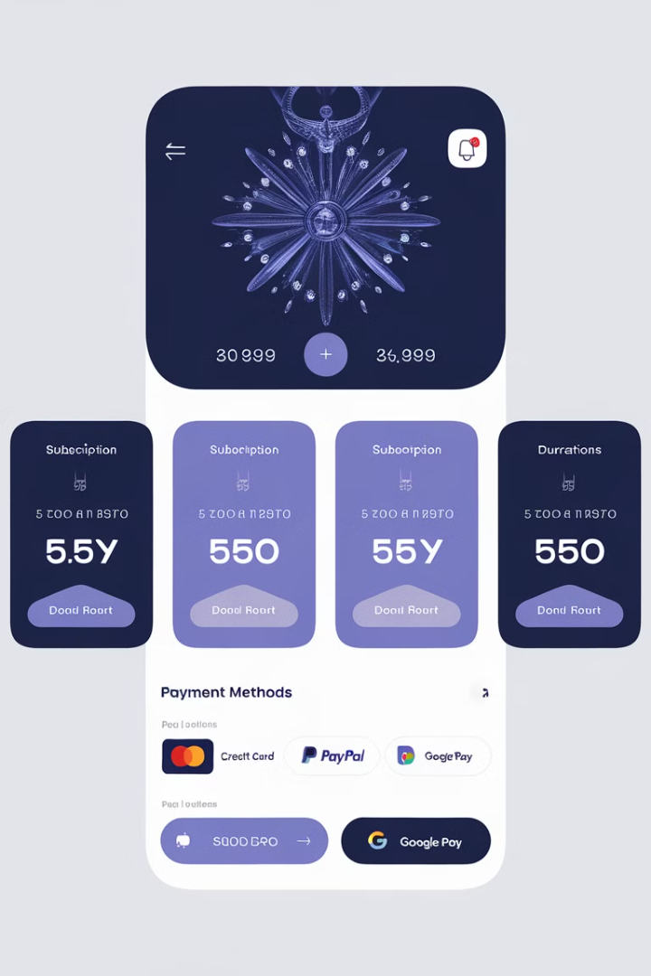
User-based Discounts & Billing
Tiered Pricing
Loyalty Programs
Implement subscription levels with varying features.
Offer rewards for long-term users.
Referral Discounts
Secure Payment Gateway
Encourage user growth through incentivized referrals.
Integrate reliable transaction processing system.

Slide 18




Deployment & Launch
Cloud Deployment
Utilizes both public and private cloud environments for flexibility and security.
Implements advanced security protocols in the cloud to protect sensitive customer data and transactions.
Marketing Campaign
Execute promotional strategies across various channels.
Analytics Setup
Track the number of new users registered during the campaign.
Monitor interaction levels on social media and email open/click rates.

Slide 19

Post Launch Support & Maintenance
1
Bug Fixes
2
Feature Updates
Address user-reported issues promptly.
Roll out new functionalities based on user feedback.
3
Performance Monitoring
4
Customer Support
Provide timely assistance through multiple channels.
Continuously optimize app performance and stability.

Slide 20
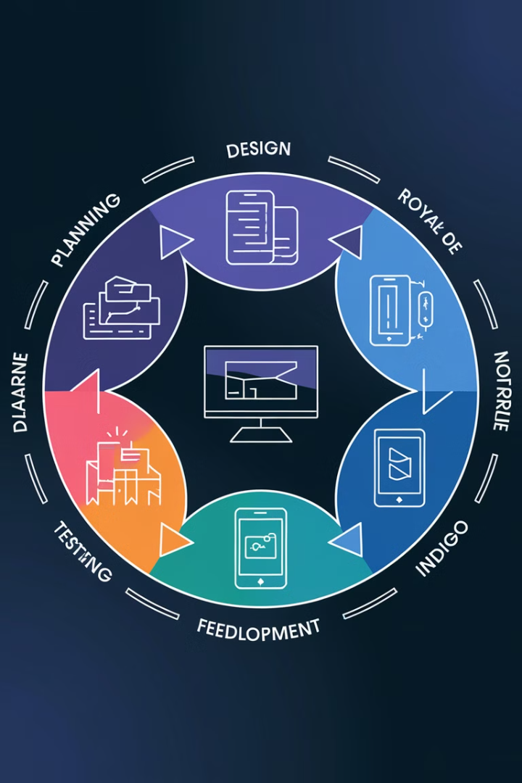
Continuous Improvement Cycle
Collect User Feedback
Analyze Usage Data
Identify Improvement Areas
Prioritize Updates
Develop Enhancements
Test New Features
Release Updates
Monitor Impact

Slide 21
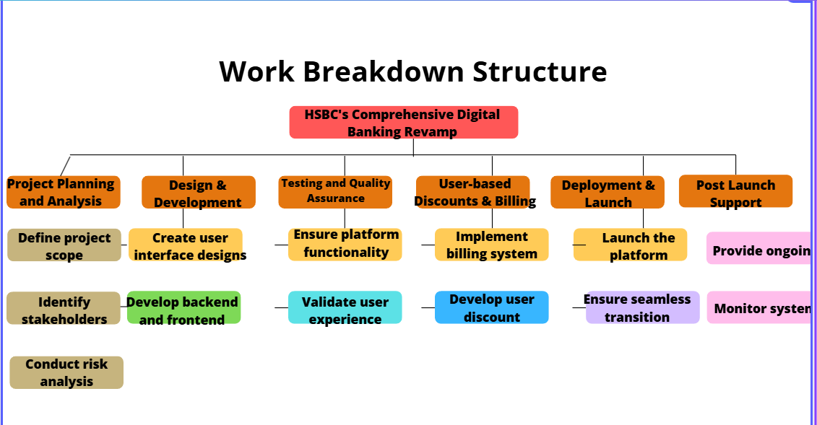

Slide 22

Q & A

Slide 23

Thank You

